Slide 1
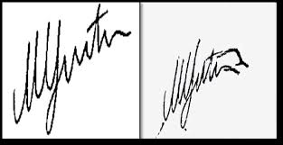
SIGNATURE VERIFICATION USING COMPUTER VISION
Presented By:- Shivansh Purwar 1805213054
Abhishek Kumar Batham 1805213003 Saumitra Dhar Dubey 1805213051
Kaushlendra Kumar 1805213026
Supervised By:- Dr. Pawan Kumar Tiwari Ms. Deepa Verma

Slide 2
INTRODUCTION
In forensic & biometrics departments automated signature verification are most beneficial task and it was used to authorized authenticity of person.
In case of online system, signature are processed on electronic tablets and saved as image.
Signature verification is a type of software that compares signatures and checks for authenticity.
This saves time and energy and helps to prevent human error during the signature process and lowers chances of fraud in the process of authentication.
Our Project aims to carry out the task of detecting the forgery as well as the genuine image.

Slide 3
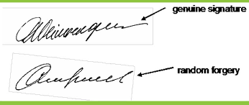
OBJECTIVE
To build and design a deep learning framework to process the signature
images and thus diagnose them as a forge or genuine.

Slide 4
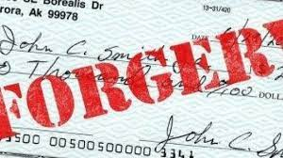
WHY SMART SIGNATURE VERIFICATION?
▶ Automation and Reduction of Human Effort
▶ Artificial Intelligence : efficient hidden signature feature extraction and
lesser chances of forgery (Safe and Secure Systems)
▶ Big Step towards Digital India
▶ Use Case Applications :
▶ Banks, Post-Offices, Co-operative Societies and Self-Help Groups
▶ Cases where Handwritten Signatures involved : Land Registry Offices
▶ As an attendance proof of Schools, Colleges and Post Offices

Slide 5
LITERATURE REVIEW
There exist a number of biometrics methods at present, e.g. signatures, fingerprints, iris, etc. Fingerprints and iris verification require the installation of costly equipments and hence cannot be used at day to day places like banks, etc. There is considerable interest in authentication based on handwritten signature verification system as it is the cheapest way to authenticate a person. Banks and Government bodies recognize signatures as a legal means of authentication[1].

Slide 6
LITERATURE REVIEW
A handwritten signature is biologically linked to a specific individual. Modern forensic document examiners commonly compare a suspect signature with several examples of known valid signatures. They look for signs of forgery which include: Signatures written at a speed which is significantly slower than the genuine signatures; frequent change of the grasp of the writing implement; rounded line endings and beginnings; poor line quality with hesitant and shake of the line; retracing and patching; and stops in places where the writing should be free.
Signature verification problem therefore is concerned with determining whether a particular signature truly belongs to a person or not[3].

Slide 7
LITERATURE REVIEW
In offline case, signature is obtained on a piece of paper and later scanned. Offline signature verification deals with a 2D static image record of the signature. It is useful in automatic signature verification found on bank checks and documents authentication. Offline verification techniques are based on limited information available only from shape and structural characteristics of the signature image.
The target of this research is to present online handwritten signature verification system based on DWT features extraction and neural network classification. An overview on handwritten signature verification structure[5].

Slide 8
PRE-REQUISITES
Python: Overall Web-App
Django: Python Framework for backend
Heroku : Web-App Deployment Platform
OpenCV : For Image Pre-processing work.
Tesseract: To extract the texts.
TensorFlow : Signature Verification Model
Kera's : Signature Verification and OCR Model
HTML+ CSS: Front-End
JavaScript : For the Front-End work.
Ajax: Make Request to Web - Server 11.
SQLite3: Database Management System

Slide 9
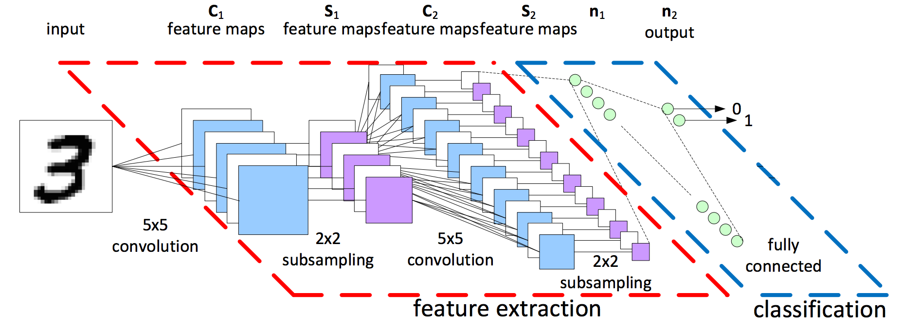
SIGNATURE – DETECTION MODEL

Slide 10
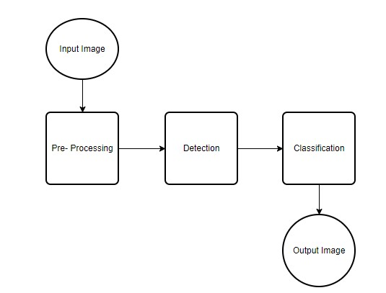
METHODOLOGY

Slide 11
Process of Verifying mandate form
This process includes four stages :-
Pre-processing – authenticating datasets in form of generalized algorithm. This includes Normalization, Gray Scaling, Resizing and Dilation.
Detection stage – signature extraction from feature mapping stage.
The last step signature classification step consists of implementing the Siamese neural network to predict the confidence score.

Slide 12
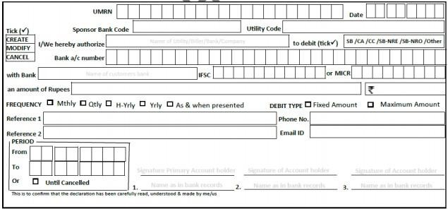
Framework:
Centralized
Database System
Reference Signatures
Signature
Recognition Model
Account Number
Confidence
Score
Signatures
Questioned Signatures
Start Date
Segmentation
Model
End Date
OCR Model
Output Details
Amount
Name
Segmented Images

Slide 13
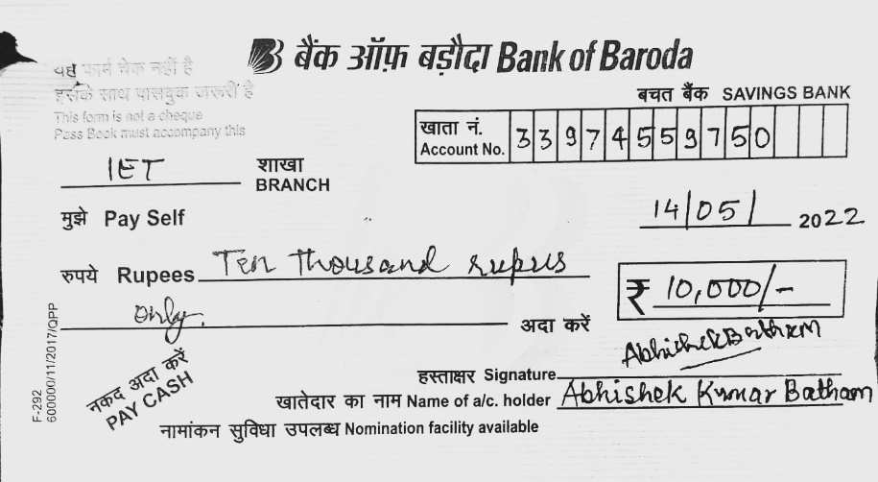
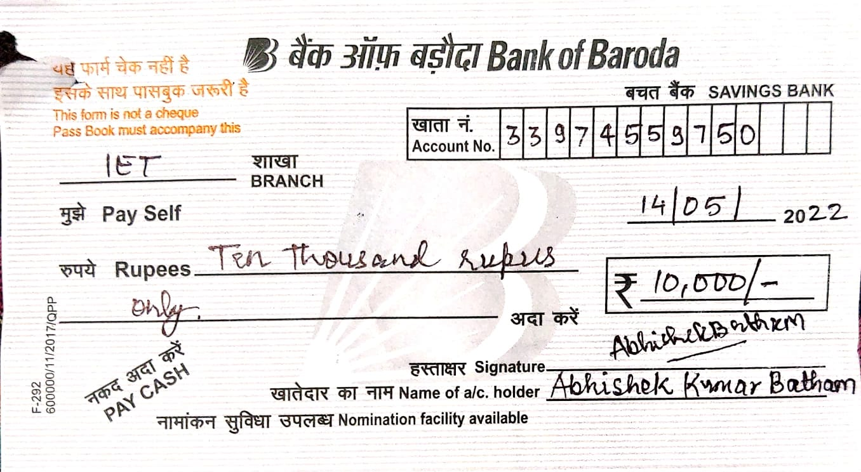
PRE-PROCESSING INVOLVED
⮮
Canny Edge Detection
& Dilation
Scanned Image
Extracted Image of
Form

Slide 14
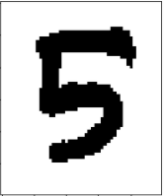


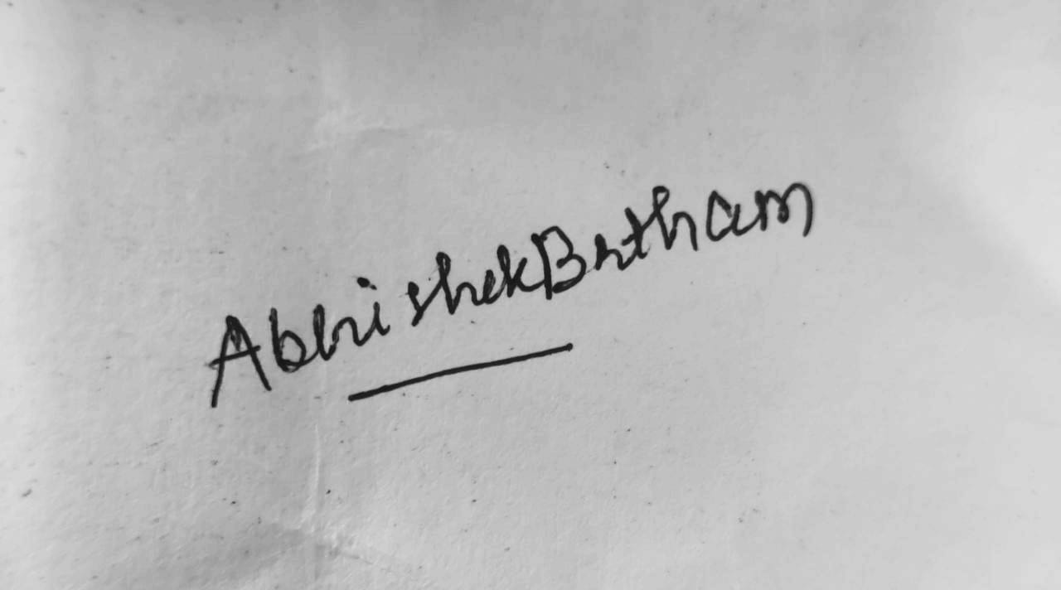
PRE-PROCESSING INVOLVED
Account Number Extracted
Account Number Segmentation
Extracted Signature

Slide 15

PRE-PROCESSING OF SIGNATURES
Gray Scaling followed by dilation

Slide 16
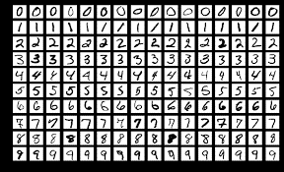
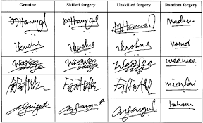
DATASET
Account Number: We have used MNIST dataset for account number recognition.
Signature Dataset: We have used English Signature dataset for signature Classification.

Slide 17
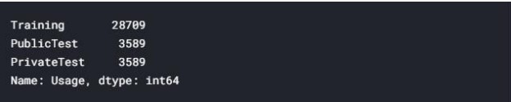
DATASETS
The Signature dataset consists of 28,000 labeled images in the training set, 3,500 labeled images in the development set, and 3,500 images in the test set. Therefore, it can be seen that images are grouped for 80% training, 10% validation and 10% test.

Slide 18
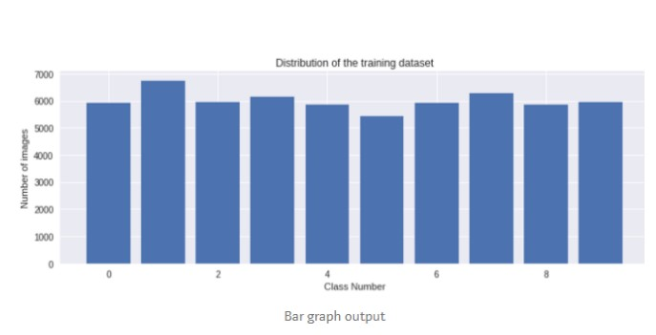
DATASETS
The Signature dataset consists of 80000, labeled images in the training set, labeled images in the development set, and 3500 images in the test set. Therefore, it can be seen that images are grouped for 80% training, 10% validation and 10% test.

Slide 19
CONVOLUTIONAL NEURAL NETWORK
A Convolutional Neural Network (ConvNet /CNN) is a Deep Learning algorithm which can take in an input image, assign importance (learnable weights and biases) to various aspects/objects in the image and be able to differentiate one from the other.
A CNN typically has three layers: a convolutional layer, pooling layer, and fully connected layer.
Convolutional Layer: The main objective of convolution is to extract features such as edges, colors, corners from the input. As we go deeper inside the network, the network starts identifying more complex features such as shape, digits, face parts as well.
Pooling Layer: Pooling layer is responsible for reducing the spatial size of the Convolved Feature.

Slide 20
5. This is to decrease the computational power required to process the data through dimensionality reduction.
6. Fully Connected Layer: Now that we have converted our input image into a suitable form for our Multi-Level
fully connected architecture, we shall flatten the image into one column vector.
7. The flattened output is fed to a feed-forward neural network and backpropagation applied to every
iteration of training.

Slide 21
SIAMESE NETWORK
Siamese network has a stack of convolutional and pooling layers and a final fully connected layer with 128 neurons.
The sister network takes on the same weights and biases as the original network (essentially means running the same network twice).
It takes the input image pair and produces two 128-D vectors as outputs.
The two vectors are then subtracted element-wise to form a single 128-D vector (not to be confused with the L1 distance function that yields just a single scalar value as output).
Well, we’re almost finished. The next part of it is a fully connected network that takes the 128-D distance vector as the input and the output layer has a single output neuron for classification with sigmoid activation.

Slide 22
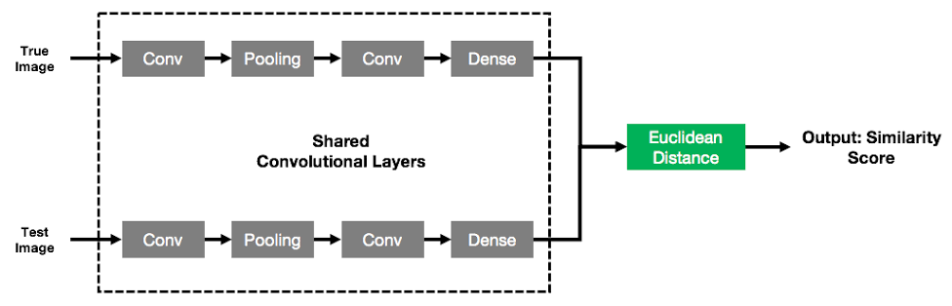
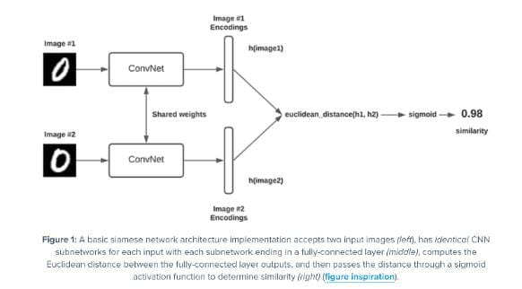
Signature Classification Model:
Siamese Network

Slide 23
SOME STATISTICAL ANALYSIS
▶ Cheque Application Volume in India : 1000000 instruments per day
▶ How RBI plans to solve the problem ? Let’s see..
▶ Cheque Truncation Project : Run on Pilot basis in Delhi NCR Region
▶ Setting up extra clearing houses : Increase in human efforts
▶ Current process is manual in Banks and a person verifies the signature
▶ Extremely High Amounts are cleared by Signature Experts in Clearing Houses
▶ Chances of Human based error more than machine based error

Slide 24
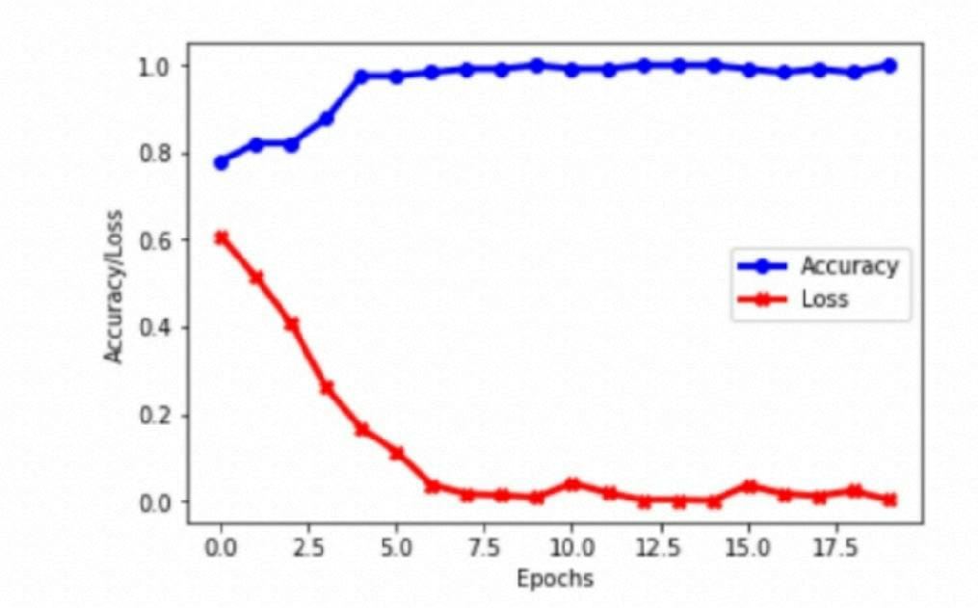
RESULT

Slide 25
Results for Segmentation Model and OCR Model : > Accuracy : 96.48% (test cases) & MNIST model : 99%
Results for Signature Recognition Model :
> Accuracy : 91%
> False Acceptance Rate (FAR) : 2.2%

Slide 26
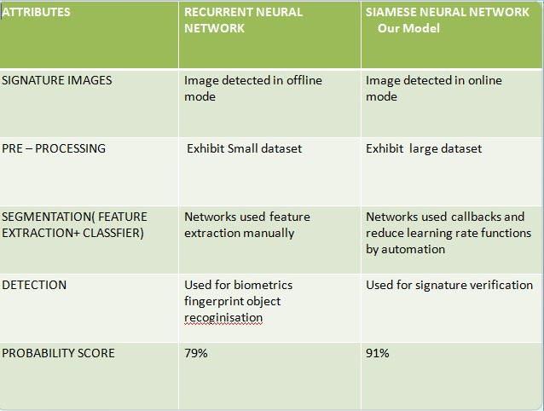
Comparison between RNN & SNN

Slide 27
CONCLUSION
Improving classification with limited number of samples - Given the severe constraints in practical applications, researchers have searched for ways to increase performance in cases where a small number of samples per user is available. In particular, the creation of dissimilarity-based writer-independent solutions, and metric-learning solutions have shown to be promising to address this problem. Augmenting the datasets - Related to the problem of having low number of samples per user, some researchers have focused in generating synthetic signatures, in order to increase the number of samples available for training. Building model ensembles - In order to increase classification accuracy, and the robustness of the solutions, some researchers have investigated the creation of both static and dynamic ensembles of classifiers.

Slide 28
FUTURE SCOPE
Can reduce Fake Signature Cases
Big step towards Digitalising Banking Solutions and reducing hassles
Highly user friendly designed for better Customer Experience
User can adopt without getting in intricacies of the model.
Aadhar Card Verification at cybercafé or Aadhar Card Centre.

Slide 29
References:
[1] Jagtap AB, Hegadi RS, Offline handwritten signature recognition based on upper and lower envelope using eigen values, WCCCT, IEEE, pp 223–226, 2017.
[2.] Hafemann, Luiz G., Robert Sabourin, and Luiz S. Oliveira, "Learning features for offline handwritten signature verification using deep convolutional neural networks.", Pattern Recognition 70 : 163-176, 2017.
[3] Soleimani, A., Araabi, B.N. and Fouladi, K., Deep multitask metric learning for offline signature verification. Pattern Recognition Letters, 80, pp.84-90, 2016.
[4.] Eman Alajrami , Belal A. M. Ashqar, Bassem S. Abu-Nasser, Ahmed J.Khalil, Musleh M. Musleh, Alaa M. Barhoom & Samy S.Abu-Naser, International Journal of Academic Multidisciplinary Research (IJAMR) ,3 (12):39-44, 2020.
[5] Tolosana, R., Vera-Rodriguez, R., Fierrez J., & Ortega-Gracia, J, DeepSign: Deep On-Line Signature Verification, IEEE Transactions on Biometrics, Behavior, and Identity Science, 3(2), 229-239, 2021.
[6] Huang, Gao, et al.” Densely Connected Convolutional Networks. “computer vision and pattern recognition (2017): 2261-2269.
[7] Bouamra, W.; Djeddi, C.; Nini, B.; Diaz, M.; Siddiqi, I. Towards the design of an offline signature verifier based on a small number of genuine samples for training.182–195,2018.

Slide 30
THANK YOU

